Slide 1
Support Classifier
Daniel Zou, Raymond Lui, Michelle Cheung, Lauren Lee

Slide 2
Scrubbing Data
Gathered data from 2 tables
Build Model
0
2
1
3
Data Exploration
Train Using Azure
Notes:
First we gathered the data from the two tables and experimented with different aggregates to reveal any possible trends to note. We then settled on the support dataframe and started data exploration by cleaning the data, and more specifically the dates. We reformatted the dates from strings to daytime objects so that we could compare them later more easily.
We also noticed that there were key words in the text column that could potentially be used to identify themes, and from there, we started to build our model and train it using Azure.

Slide 3
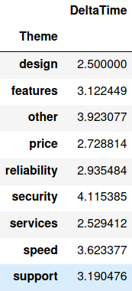
Observations
Some customer ticket themes take longer to resolve
This process can be more efficient
Notes:
Therefore, leading up to our final idea, we thought about our own customer service experiences and observed how it could be more efficient if customer service knew exactly what our problem was from the beginning.

Slide 4
Our Project
Predictor that utilizes key words to categorize a support request to the proper theme
Notes:
Our final project is a predictor that takes in key words and uses them to categorize a support request to the proper theme.

Slide 5
Why It’s Useful
Direct customers to the right department quicker
Better customer experience, better business efficiency
Notes:
Why is it useful?
When a customer calls customer service, an automated bot will ask them what they’re looking for. The bot will then redirect the customer to the right department based on what the customer says. So for example, instead of listening to a menu of options and then picking a category that only generally fits your problem description, you’ll be able to quickly present your problem and be taken exactly where it can be resolved.

Slide 6
Project Highlights
Key Phrase Extraction
Bag of Words
Azure ML Workspace
Notes:
The main tools we used used were key phrase extraction, bag of words, and Azure machine learning.

Slide 7
Project Highlights
Key Phrase Extraction
Bag of Words
Azure ML Workspace

Slide 8
Key Phrase Extraction
Text Analytics resource on Azure
Focus on more important keywords instead of distracting and redundant features
1
Notes:
We used Text Analytics to extract key phrases, so we could have a more universal model rather than training the whole text phrase and having our model be too specialized.

Slide 9
Example
My purchase history is not showing my most recent purchases….
purchase history
recent purchases
Do these garden gnomes come with money inside...
garden gnomes
1
money

Slide 10
Project Highlights
Key Phrase Extraction
Bag of Words
Azure Machine Learning

Slide 11
Bag of Words
Processed key phrases into format suited for ML
Exported to CSV
2
Notes:
The Bag of Words method is used to train our machine learning algorithm. This method allows us to create a dictionary of unique words for our training set.

Slide 12
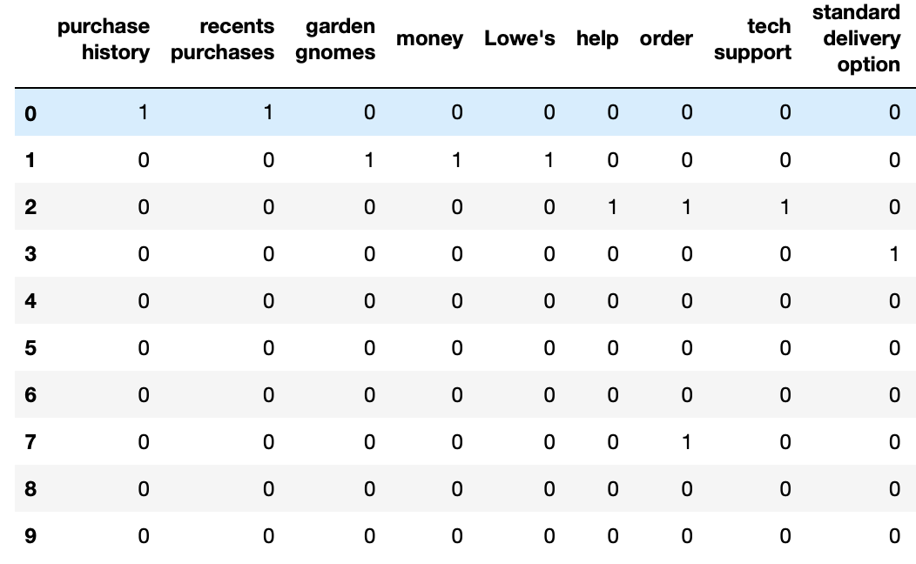
Bag of Words
2

Slide 13
Project Highlights
Key Phrase Extraction
Bag of Words
Azure ML Workspace

Slide 14
Azure ML Workspace
Upload processed data to Azure cloud for high performance training
Tried to train classification model to predict the theme of a new ticket
3
Notes:
-After we squashed the bugs in our bag of words, we decided to continue on and explore using Microsoft Azure Machine Learning workspace to train our data.
-Our plan was to use a support-vector machine model to classify and predict the theme of a new customer service ticket.

Slide 15
Example
I urgently need this by this Tuesday. Can you ship it out as soon as possible?
Urgently
This Tuesday
ship
3
Speed
Notes:
So we would match the key words from a new ticket (which in our example *read sentence* our key words would be urgently, this Tuesday, and ship) We then try and match that with the keywords in the training data that we have. The classification model will then return the best prediction for the theme, which in this case, should be speed.

Slide 16
Further Development
Finish training ML model on Azure workspace
Spelling autocorrector (devlivery vs. delivery)
Larger dataset
Notes:
We spent some time reading and grasping the documentation for Azure ML since it was new to all of us, so we weren’t able to finish implementing our classification model. In addition to that, we found it harder to collaborate on code than in person.
One improvement we would like to implement is an spelling autocorrect. We noticed that there were multiple keywords for the same exact word because there were spelling typos in the transcript (one we saw was devlivery vs delivery). A spelling autocorrector, as well as a larger dataset would allow us to build a more accurate classifier.

Slide 17
THANK YOU
Any questions?

